Slide 1

EO Atlanta Spring Getaway
Your adventure awaits!
April 11 – 14, 2024
Greenough, MT

Slide 2
SPRING GETAWAY DETAILS
The Resort at Paws Up
Greenough, MT
Thursday, April 11 – Sunday, April 14
TRIP PACKAGE
Lodging in a 3-bedroom Wilderness Estate
Breakfast, Lunch, Dinner & Bar*
Resort Activities
Group Event
Round Trip Airport Transfers from Missoula
Lexus SUV/Home for guests’ use
24/7 Transportation throughout Property
Private Access to the Paws Up Ranch
All Gratuities (“Gratuity-Free Property”)
Taxes and Service Fees
*Guests are responsible for bar tabs above $75/day/person.
RECOMMENDED TRAVEL
Delta Air Lines
ATL to MSO (Missoula, MT)
Layover SLC (Salt Lake City, UT)
  4/11 Depart 12:15pm
  Arrive 5:51pm
  4/14 Depart 12:10pm
  Arrive 9:26pm
  The resort is 45 minutes from MSO. Transportation will be provided.
PACKAGE FEES
Couple (2 people, King Suite): $5,100
Travel Buddies (2 people, Queen Suite): $2,550 per person
Individual (1 person, Queen Suite): $3,970

Slide 3
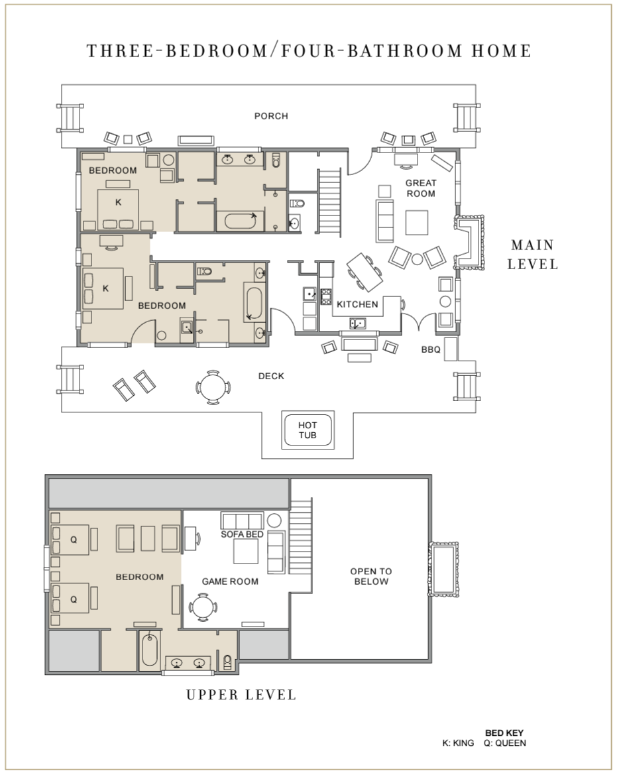
WILDERNESS ESTATES
We have reserved four (4) Wilderness Estates for the
EO Atlanta Spring Getaway.
Each home features panoramic vistas, unparalleled privacy and an extensive list of features, including a great room with a soaring vaulted ceiling, a beautiful stacked stone and natural timber fireplace, a chef’s kitchen, and outdoor hot tub.
There are three (3) Suites in each home.
Main Level – two (2) Suites with King Beds
Upper Level – one (1) Suite with 2 Queen Beds + Lounge Area
Houses will be filled in order of reservations. If you are traveling as a group (or forum), please provide Rhonda with the list of your group. Maximum six (6) people per home – no exceptions.

Slide 4
SPRING GETAWAY DETAILS
The Resort at Paws Up
Greenough, MT
Thursday, April 11 – Sunday, April 14
WEEKEND ITINERARY Thursday, April 11 – Sunday, April 14
Thursday | Arrivals + Dinner On Your Own
Friday | Breakfast & Lunch On Your Own Your Choice of Excursions & Activities Group Dinner at The Trough
Saturday | Breakfast & Lunch On Your Own Your Choice of Excursions & Activities Group Dinner & Party at The Bull Barn
Sunday | Breakfast On Your Own Departures
ACTIVITIES Inclusive & Guided
The Resort at Paws Up a variety of activities from spa services and wilderness workshops to ATV tours and Cattle Drives. Some activities are included in your resort stay, while other require an additional fee. Follow this link to access the spring activities catalog: SPRING ACTIVITIES You will book your activities directly with the resort after your reservation has been confirmed.

Slide 5
FAQs
Can I bring my children or a guest?
Members may bring up to one guest. Guests must be 21 years or older.
A group of us want to stay in the same house. How do we do this?
Please email Rhonda the names of the guests in your group and we will assign you to the same house. Please keep in mind, there is a 6-person capacity for each house.
Our forum would like our own house, but we need more rooms. Is that possible?
The resort has a few home options (subject to availability), and we will be happy to help you coordinate with them. Additional fees may apply.
I would like to arrive early/stay late, what do I do?
You will need to book a separate reservation to arrive early or stay after the group departs. Please work with Rhonda to book through our designed sales manager.
Are there any discounts on the food if we don’t eat breakfast or lunch on property?
The Resort at Paws-Up is all-inclusive. Food & Beverage is included in all packages as a standard fee for all guests.
What should I pack?
Pack according to the weather, your individual activities and any guidelines provided on the resort website (www.pawsup.com). The group events are casual.

